Slide 1
Chapter 10
Neural Networks: Learning
Cost function
Begin with the above, talking about a learning algorithm for fitting the parameters of neural network given the training set.

Slide 2
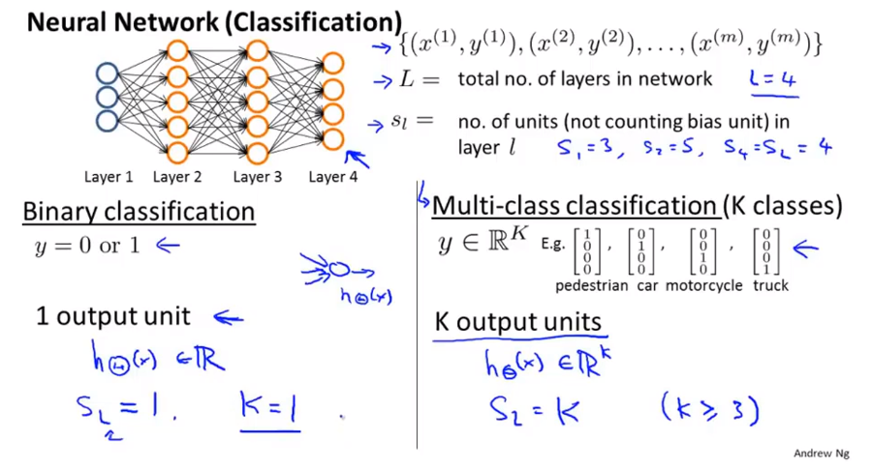
Chapter 10

Slide 3
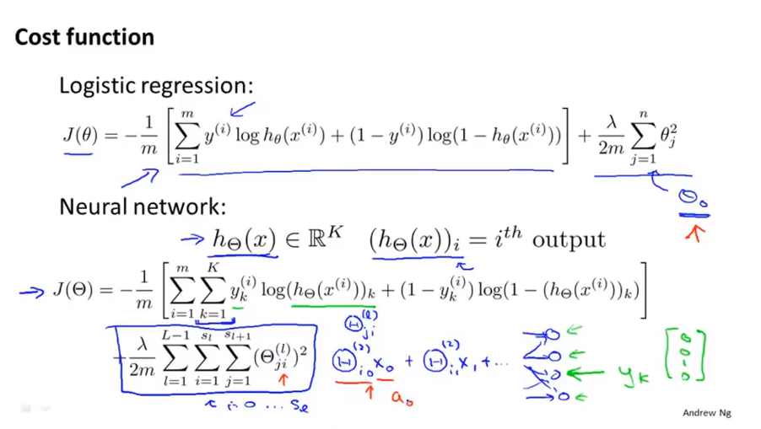
Chapter 10
L = total # of layers in network sl = # of units
K = output units == # classification

Slide 4
Chapter 10
Neural Networks: Learning
Backpropagation algorithm

Slide 5
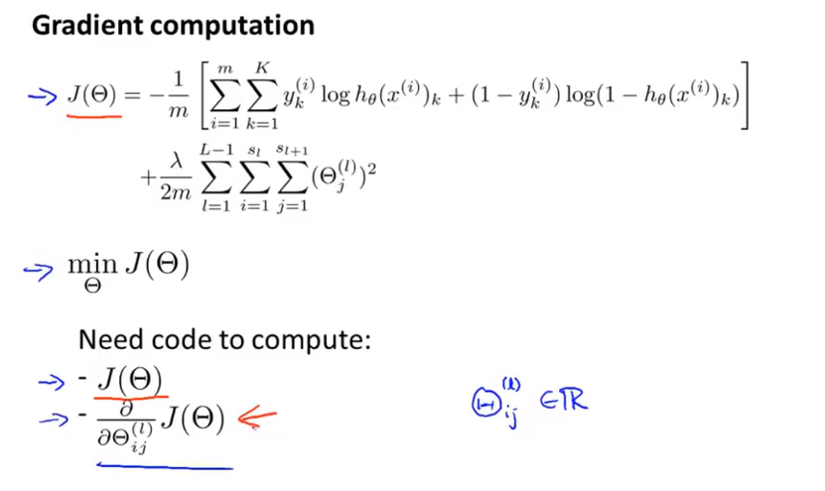
Chapter 10

Slide 6
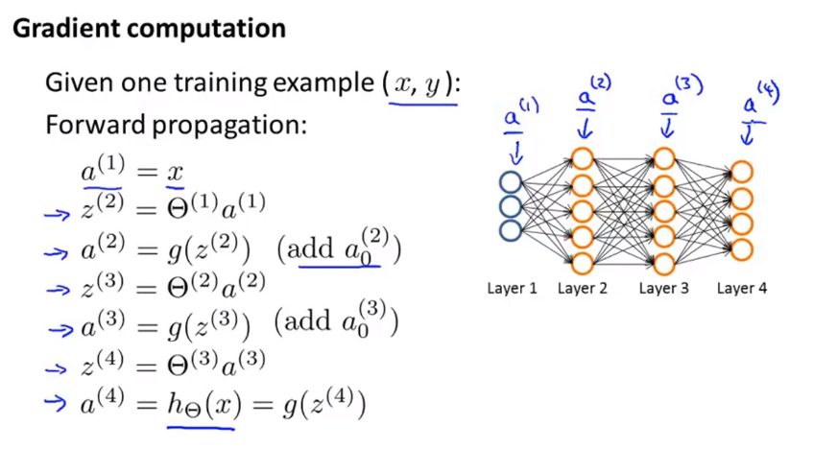
Chapter 10

Slide 7
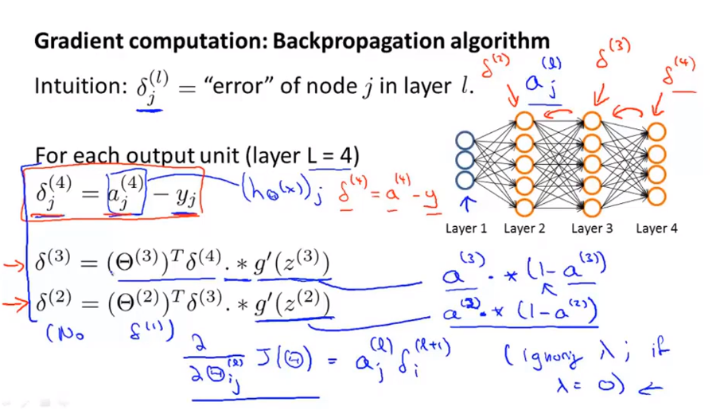
Chapter 10

Slide 8
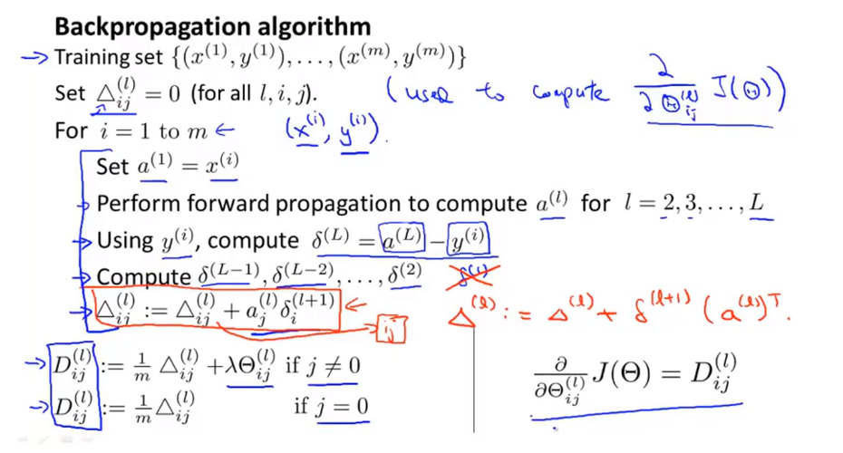
Chapter 10

Slide 9
Chapter 10
Neural Networks: Learning
Backpropagation intuition

Slide 10
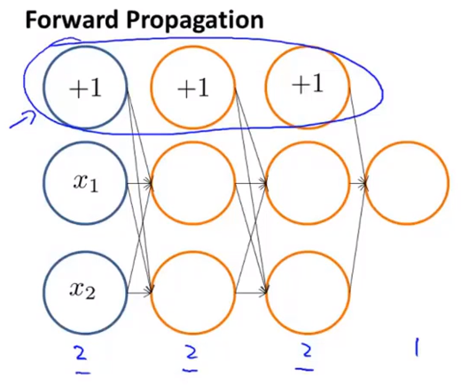
Chapter 10

Slide 11
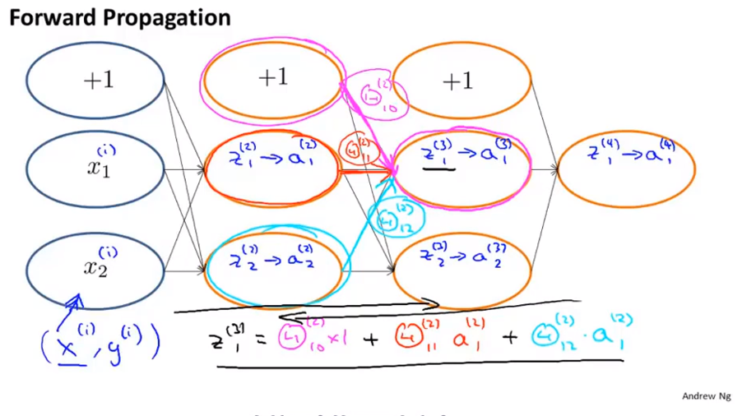
Chapter 10
Z21 weighted sum of inputs of the input unit
Apply sigmoid function to Z21 to get a21

Slide 12
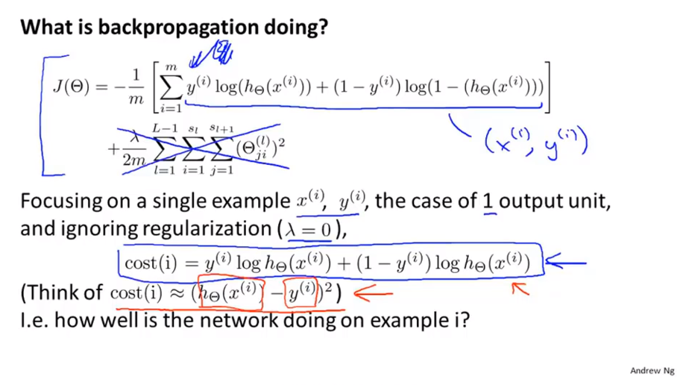
Chapter 10
For understanding, you can think cost as square error.

Slide 13
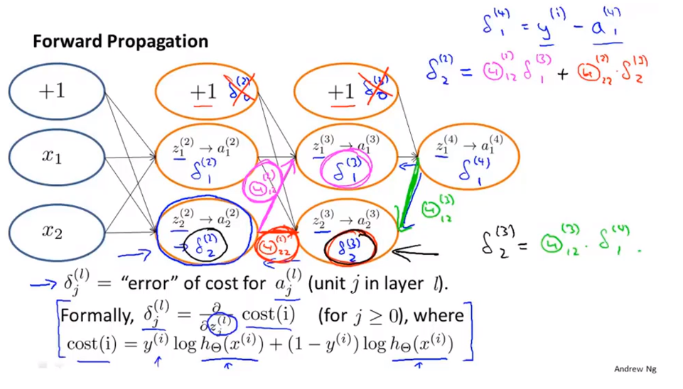
Chapter 10

Slide 14
Chapter 10
Neural Networks: Learning
Implementation note: Unrolling parameters
Implementation detail of unrolling your parameters from matrices into vectors,
which we need in order to use the advanced optimization routines

Slide 15
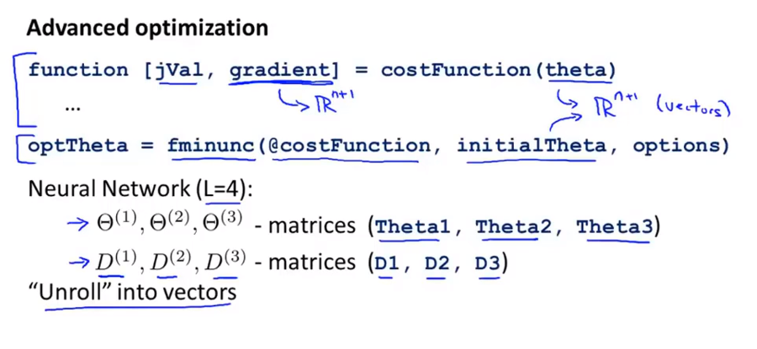
Chapter 10

Slide 16
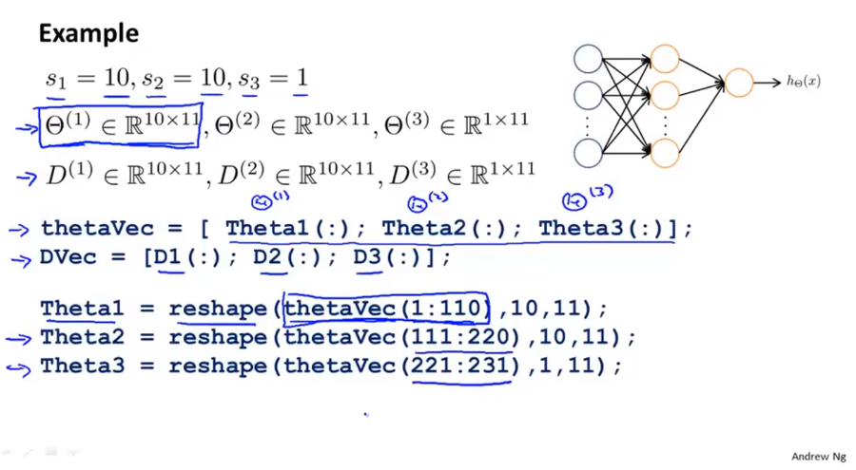
Chapter 10

Slide 17
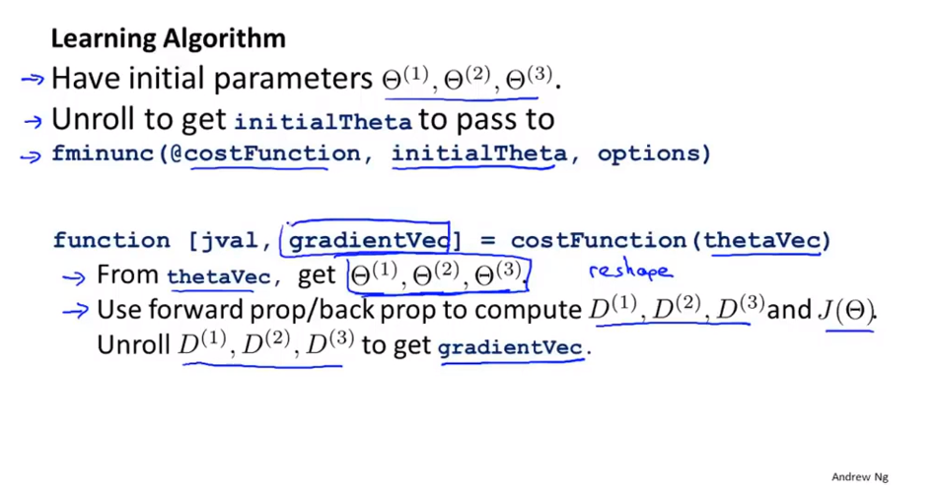
Chapter 10

Slide 18
Chapter 10
Neural Networks: Learning
Gradient checking

Slide 19
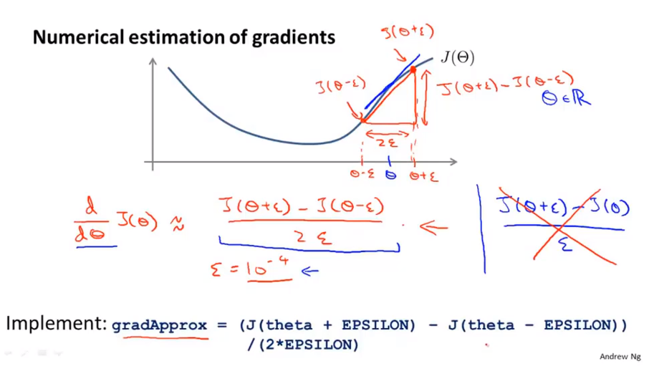
Chapter 10
two-sided difference one-sided difference

Slide 20
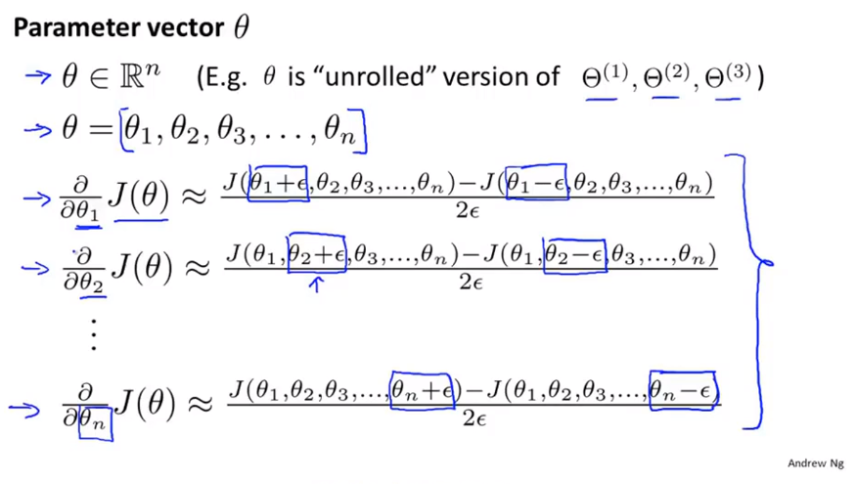
Chapter 10

Slide 21
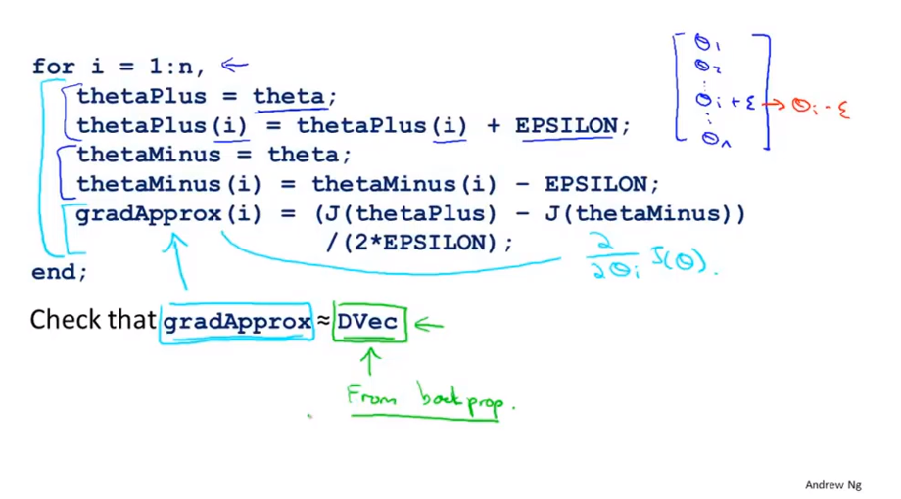
Chapter 10

Slide 22
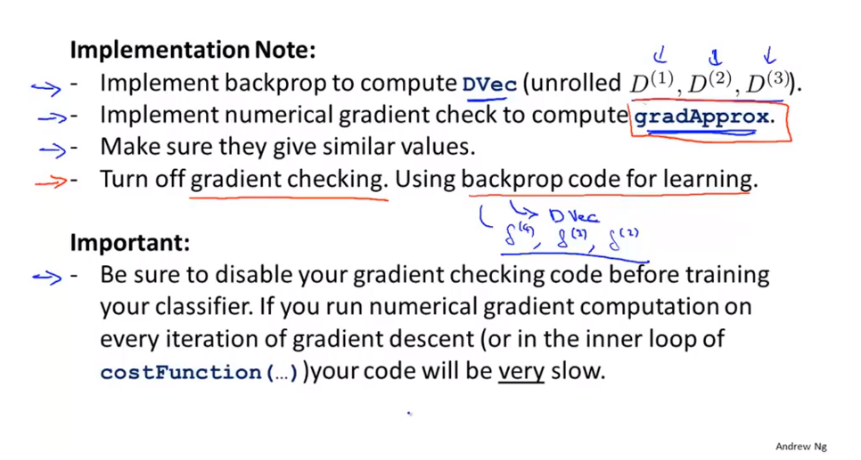
Chapter 10

Slide 23
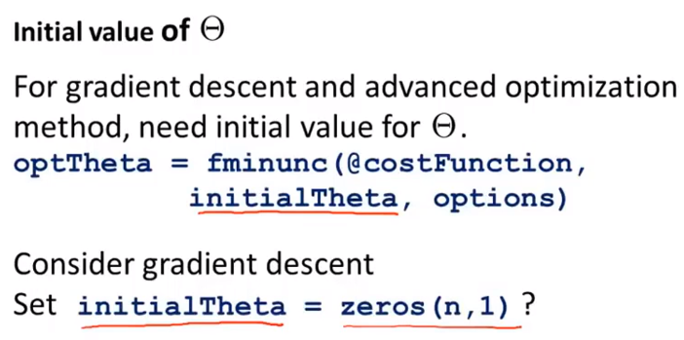
Chapter 10
Neural Networks: Learning
Random initialization
Initialized of all parameter to zero doesn’t work for neural network.

Slide 24
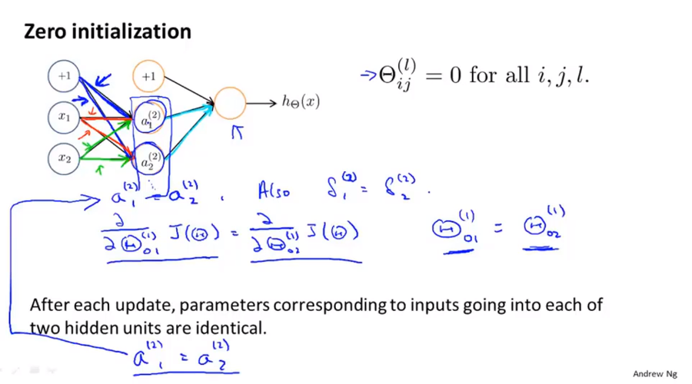
Chapter 10
Problem of symmetry weights

Slide 25
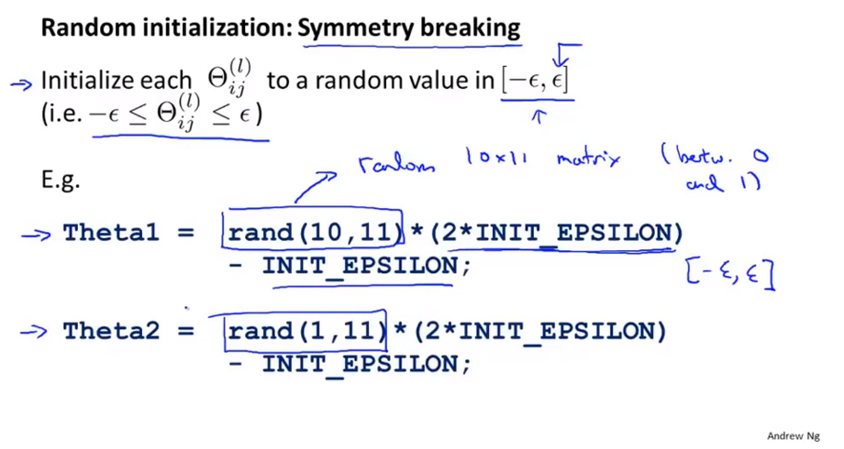
Chapter 10

Slide 26
Chapter 10
Neural Networks: Learning
Putting it together
Put all the pieces together, to give a overall summary or a bigger picture view of how all the pieces fit together and of the overall process of how to implement a neural network learning algorithm.

Slide 27
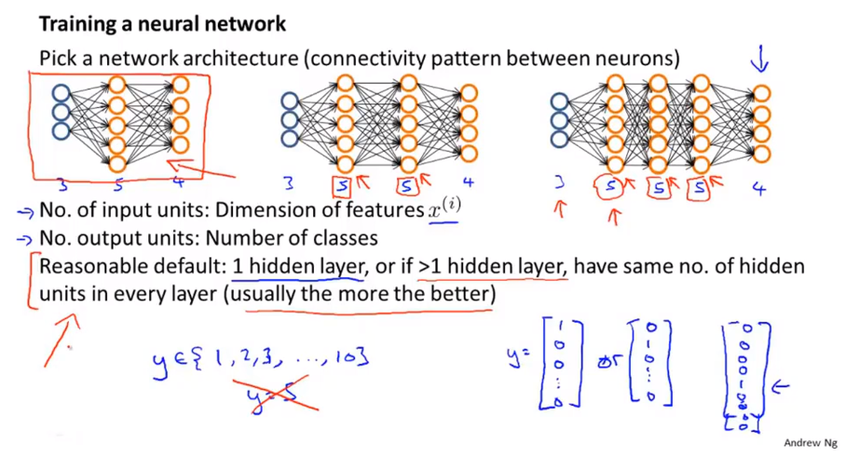
Chapter 10
Usually, the more hidden units the better.
If you have a lot of hidden units, it become more computationally expensive. But very often, having more hidden units is a good thing.

Slide 28
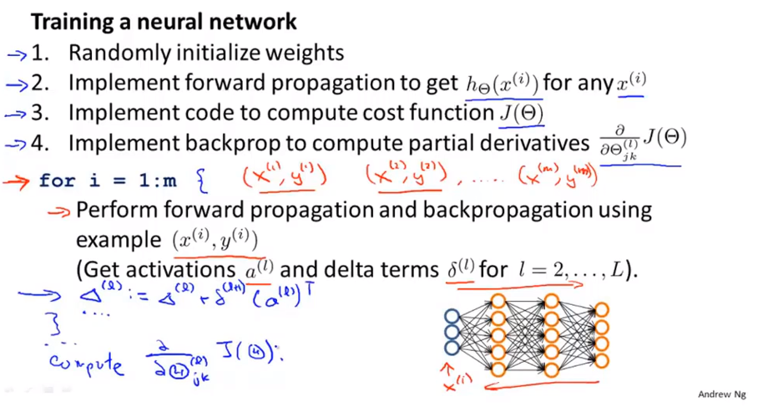
Chapter 10

Slide 29
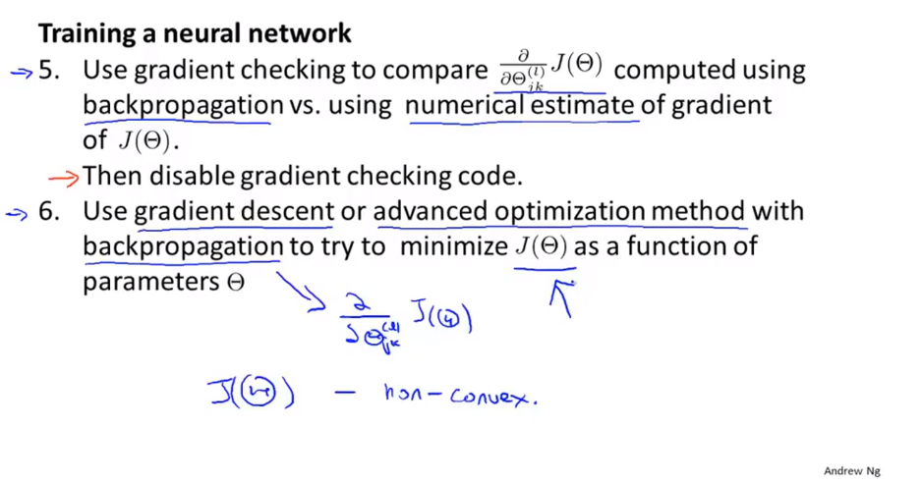
Chapter 10

Slide 30
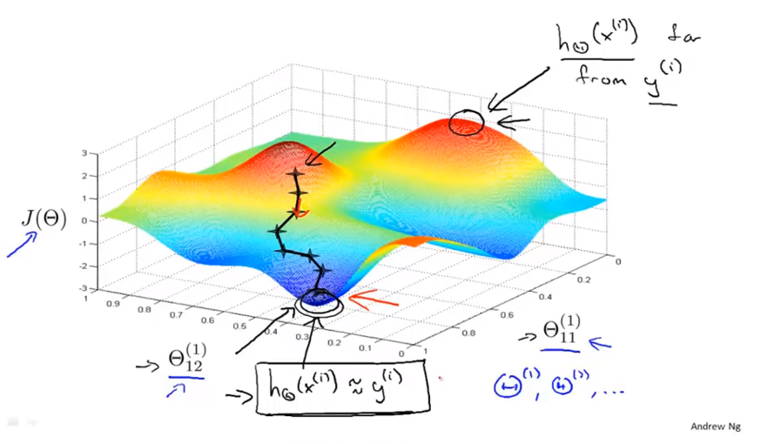
Chapter 10

Slide 31
Chapter 10
Neural Networks: Learning
Autonomous driving example

Slide 32
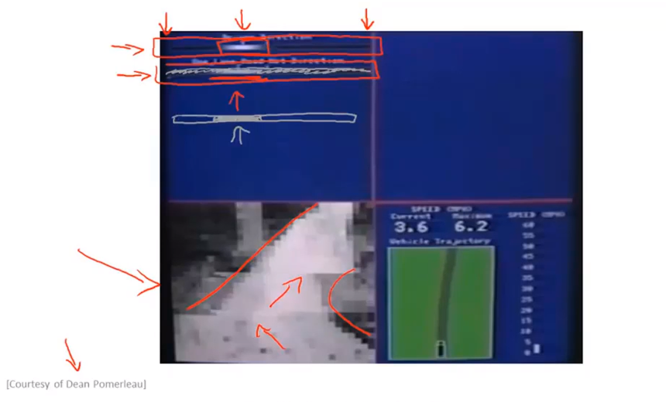
Chapter 10

